Slide 1
Group 10 Presentation for Project 3
Group Members: Peilu Zhang, Rui Zhang, Qingyang Zhong, Chun Zhai

Slide 2
Baseline:
8 neighbors + GBM (depth=1)
Improvement:
Parameter Improvement for GBM:
Try different depth (3 ~ 11)
Feature Improvement:
Add more neighbors (24 neighbors in total)
Model Improvement:
1. XGBoost
2. Random Forest

Slide 3
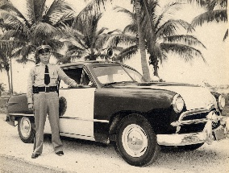
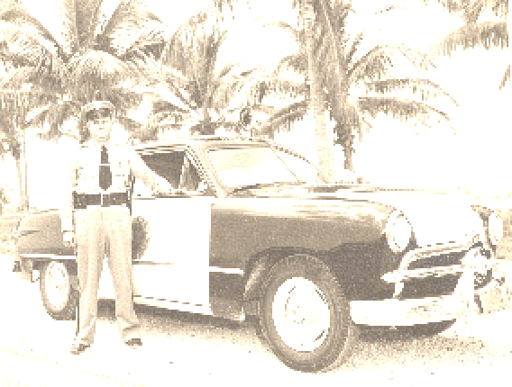
Baseline: 8 neighbors + GBM (depth=1)
We use 1750.044s to train this model.
The MSE of GBM model(depth = 1) is 0. 5%. And the training PSNR is 9.05.
The predictive HR picture is not that good :(

Slide 4

Improvement 1 – GBM:
We use cross validation to find best parameter of depth among {1,3,5,7,9,11}. And our results shows when depth = 11, we got the smallest MSE, which is 0.44%. The training PSNR is around 24.
improved a little :)

Slide 5
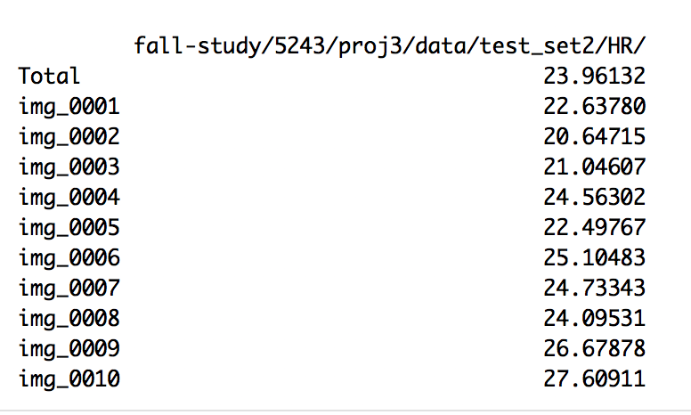
Improvement 1 – GBM:
We use cross validation to find best parameter of depth among {1,3,5,7,9,11}. And our results shows when depth = 11, we got the smallest MSE, which is 0.44%. The training PSNR is around 24.

Slide 6
Improvement 2 – Model Comparison:
Random Forest model is too slow in regards of running time, so we decide not to move on with it at this time:
Final Model: 50 images 300 points
This model has smaller MSE but too slow to test 1000 picture in class.
par_best = list(mtry = 5, ntrees = 500)
cv_error = 0.0027
PSNR = 28.3
Running Time:
For CV: 24 hr
For SuperResolution: 1.5min/pic

Slide 7
Improvement 3 – Feature Comparison:
Next, we compared the results of the following combinations:
8 Neighbors + GBM par_best = depth 11 cv_error = 0.0044 PSNR(test 10 images) = 23.96 tm_feature_train(train 1490 images) = 99.291 s tm_train(train 1490 images) = 1750.044 s tm_super = 9s/image | 24 Neighbors + GBM par_best = depth 11 cv_error = 0.0043 PSNR(test 10 images) = 24.02 tm_feature_train(train 1490 images) = 140.33 s tm_train(train 1490 images) = 3405.472 s
8 neighbors + XGBoost par_best = list(depth = 3,nrounds = 55) cv_error = 0.00375 PSNR(test 10 images) = 26.75 tm_feature_train(train 1490 images) = 99.291 s tm_train(train 1490 images) = 2115.065 s tm_super = 7s/image | 24 neighbors + XGBoost par_best = list(depth = 5,nrounds = 60) cv_error = 0.00306 PSNR(test 10 images) = 26.78 tm_feature_train(train 1490 images) = 140.33 s tm_train(train 1490 images) = 3886.72 s

Slide 8
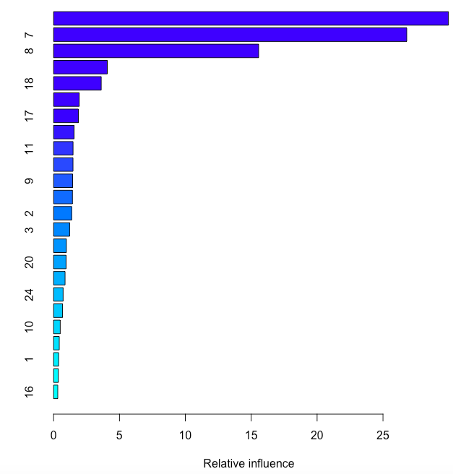
Improvement 3 – Feature Comparison:
The improved feature does not generate much improvement on the results for both GBM and XGB. The top 4 neighbors that have high relative influences are all from inner neighbors. Also, due to the longer running time of the improved feature, we consider it not more efficient compared with baseline feature.
Therefore, we decide to use the combination of baseline feature (8 neighbors) and XGBoost model as our final model in the end.

Slide 9
Improvement 3 – Feature Comparison
Why XGBoost?
XGBoost learns a better tree structure by using Hessian, which is a higher-order approximation.
XGBoost uses penalization of complexity to control over-fitting (eta=0.1).
The randomization that XGBoost applies includes row subsampling at each iteration which can reduce the correlation between trees.
XGBoost Improves data structures for better processor cache utilization and significantly reduces memory cost.
XGBoost provides better support for multiple cores processing to parallelize the tree formation which reduces overall training time.

Slide 10

Final Model Visualization:
Output: 8 neighbors + XGBoost (depth=3, nrounds=55)

Slide 11
Next Steps:
Try padding in other ways (replicate padding & reflect padding)
Try extracting key points (SIFT)
Tune more parameters for XGBoost model
Optimize algorithm to run faster

Slide 12
Thank you!

